Slide 1
Fast, flexible DO-178C tool qualification using a modular approach
Ian Broster, Zoë Stephenson,
David Allsopp, Sevane Fourmigue, Daniel Wright
ianb@rapitasystems.com
This research was funded by the E.U. ECSEL project AMASS.

Slide 2


What is a qualification kit in DO-178C?
Tool Vendor
Software Supplier
Airframe Manufacturer
Examples of evidence:
1. RapiCover does not alter functionality of the code under test
2. RapiTest accurately inserts test vectors and checks results
Aerospace Software
Aircraft
C/C++
To DER for approval
Evidence
(Qualification Kit)
Evidence
Evidence
Integration Tests
Tool Qualification evidence is needed when
you meet an objective using a tool whose output is not independently checked

Slide 3
What is inside a DO-178C/DO-330 qualification kit?
Process
DO-330 is guideline/process for generating that evidence
Evidence you can trust the output of a tool
4 documents:
Requirements and tests
 | Plan | Evidence
Process evidence: | TQP Tool Qualification Plan How will you meet the guidelines? | TAS Tool Accomplishment Summary Did you meet the guidelines?
Product evidence: | TOR Tool Operational Requirements What should the tool do? | TVR Tool Verification Records Does the tool do what it should?

Slide 4
How to make a qualification kit
TQP
Review
TAS
Lots of
manual work,
Reviews, …
Already
Automated
TOR
Review
TVR
HLR
Test Results
Review
Tests Plans
Tests

Slide 5
Practical Tool Qualification Problems
Maintenance:
  Traceability hard to maintain (error-prone). Automatic check.
  Change management (e.g. when you change something, what does it affect? )
Manual reviews: lots
  want to be able to finish part and know it needs no change
Hard to parallelize development
  hard to understand state at any time, lots of interactions between different parts
  Development tends to be ahead of the qualification.
Product variants:
  Hard to share “common” qualification data between products/components.
Hard to use versions/branches/configuration control on large documents

Slide 6
Modular concept – fine grained artefacts
QK: Tool automation
Cross checking
Version checks
Dependency checks
Document generation
Product line selection
HLRs
TOR
HLR
Test Plans
Tests Plans
Tests
Tests
Deps
Test Results

Slide 7


Product lines and variants
Select groups of requirements…
Different Products
Different Versions
Customised qualification kit
  Match scope to what the customer is claiming credit for
  Less effort for the customer to review!
HLR modules
Test Plans
Tests

Slide 8
Example Product Variant
Test Plans
Tests
RPC_COV_067_Ada
RPC_COV_067_Ada.rtt
RPC_COV_067
RPC_COV_076_C
RPC_COV_067_C.rtt
RPC_COV_076_C++
RPC_COV_067_C++.rtt
When invoked with the `--no-rewrite-returns` option, instrumenters shall not modify the structure of return statements.
Selections
Tool: RapiCover
Language: Ada
Other examples:
Different definitions of MC/DC
Bitwise operator definitions
Different embedded compilers

Slide 9

What is a module
requirement RPC_COV_067 => text {
When invoked with the `--no-rewrite-returns` option, instrumenters shall not modify the structure of return statements.
};
scope{
This needs to be checked on return with no value, return of a plain expression with two operators, a function call, an expression of function calls, function call with parameters as expressions with two operators and function calls of function calls. See rules C_003 and A_005 in [INS].
};
deleted "`--assume-src-order` argument irrelevant to coverage with removal of `--coverage-trace` options", requirement RPC_COV_068 => text {
Requirement deleted.
};
.darts file
.darts file
.darts file
.darts file
Text files (diff, grep,..)
Domain specific language.
Can “include” each other
Can reference each others
Describes requirements, document structure, review comments, …

Slide 10
-- /*PASS */
-- /*TOOL adains*/
-- /*OUTPUT rpc_cov_067_ada.out */
-- /*PS
-- delete_full (qw< *.exf *.out *.xsc *.adt *.ali > );
-- shell_cmd ("gcc -c -gnatc -gnatt rpc_cov_067_ada.adb");
-- */
-- /*OPTS -u --exf tmp.exf -c rvs_instr.h --coverage-map */
-- /*INPUT rpc_cov_067_ada.adt */
-- /*AS
-- assert 0 == string_count_section_no_case ('return rvs_return_tmp', 'function '.'f0', 'end '.'f1', "rpc_cov_067_ada.out");
-- assert 4 == string_count_section_no_case ('return rvs_return_tmp', 'function '.'f2', 'end '.'f5;', "rpc_cov_067_ada.out");
-- */
-- /*TEST */
-- /*OPTS -u --exf tmp.exf -c rvs_instr.h --no-rewrite-returns --coverage-map */
-- /*AS
-- # 'return return_tmp' will appear in the .out file, this is due to the RVS Wrap and is not a cause for test failure
-- assert 0 == string_count_section_no_case ('return rvs_return_tmp', 'function '.'f0', 'end '.'f5;', "rpc_cov_067_ada.out");
-- */
-- /*TEST */
…
with pkg1;
procedure rpc_cov_067_ada is
a : Natural := 0;
function f0 return Natural is
begin
return 0;
end f0;
function f1 return Natural is
begin
a := a + 1;
return a + 1 * 3;
end f1;
function f2 return Natural is
begin
a := a + 1;
return pkg1.rewriter( a );
end f2;
….

Slide 11
How else does modular help?
Use branches easily
No binary documents
  diff
  Version control at line level (e.g. subversion, …)
Multiple people editing artefacts at the same time
  They are not editing the same document
Micro-level reviews possible, instead of whole document
  When it’s reviewed, it’s finished.
More powerful automated checking of traceability

Slide 12
QK: Custom tooling structure
.darts file
.rtt (test) file
.darts file
.rtt (test) file
“compiler”
Errors
Object models
“linker”
Problem reports
Trace matrix
System model
“Run”
Qualification documents
Use cases:
  1. Generation of qualification kit/documentation
  2. Checking of qualification kit
  3. Management of team/progress tracking, (continuous integration)
Requirements documents
Results summaries
Management reports

Slide 13
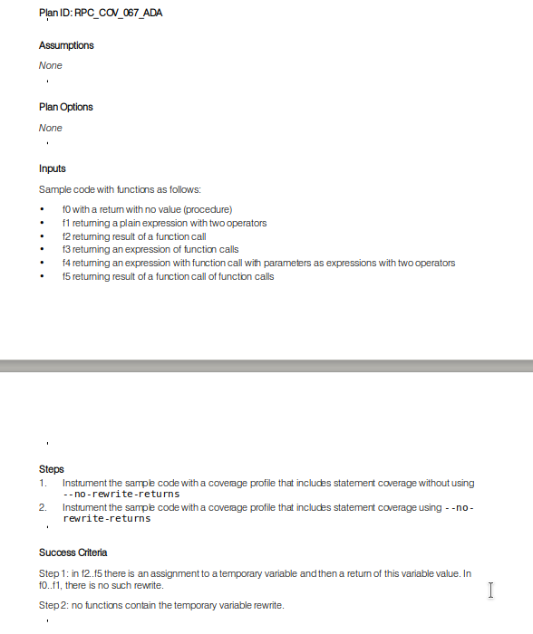
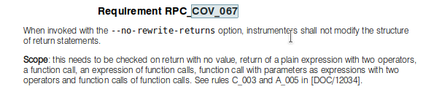
Extract from Documents
Test Plans
HLR

Slide 14
Automated checking and tracking requirements
Traceability checks:
  all requirements covered,
  all requirements tested,
  all requirements/tests reviewed
Versioning:
  all derived items are newer than their source
  e.g. if you change a requirement, has it been reviewed, have the tests changed etc?

Slide 15
Outputs of tool
Message list:
[MAJOR-ERR] trace source 'requirement:WIG:RVS_WIG_093' is at revision 119993, which is newer than trace target 'requirement:WGZ:RVS_WGZ_029' at revision 119286
[MAJOR-ERR] trace source 'requirement:WIG:RVS_WIG_094' is at revision 119530, which is newer than trace target 'requirement:WGZ:RVS_WGZ_030' at revision 119286
[MAJOR-ERR] trace source 'testplan:WIG:RVS_WIG_069' is at revision 120380, which is newer than trace target 'testplan:WGZ:RVS_WGZ_010' at revision 119286
[MAJOR-ERR] element 'requirement:CDC:RPC_CDC_020' requires review
[MAJOR-ERR] element 'requirement:CDC:RPC_CDC_021' requires review
[MAJOR-ERR] element 'requirement:CDC:RPC_CDC_022' requires review
--
Action list:
--
"RVS_WGZ_029",,!ebatchelor,update,requirement,,"modules\WGZ\Compile.darts","trace source 'requirement:WIG:RVS_WIG_093' is at revision 119993, which is newer than trace target 'requirement:WGZ:RVS_WGZ_029' at revision 119286"
"RVS_WGZ_030",,!ebatchelor,update,requirement,,"modules\WGZ\Compile.darts","trace source 'requirement:WIG:RVS_WIG_094' is at revision 119530, which is newer than trace target 'requirement:WGZ:RVS_WGZ_030' at revision 119286"
"RVS_WGZ_010",,!ebatchelor,update,testplan,,"modules\WGZ\Test Plan\RVS_WGZ_010.darts","trace source 'testplan:WIG:RVS_WIG_069' is at revision 120380, which is newer than trace target 'testplan:WGZ:RVS_WGZ_010' at revision 119286"
"RPC_CDC_020",,,review,requirement,,"","element 'requirement:CDC:RPC_CDC_020' requires review"
"RPC_CDC_021",,,review,requirement,,"","element 'requirement:CDC:RPC_CDC_021' requires review"
"RPC_CDC_022",,,review,requirement,,"","element 'requirement:CDC:RPC_CDC_022' requires review"

Slide 16
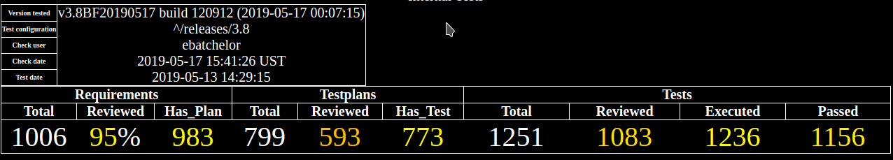
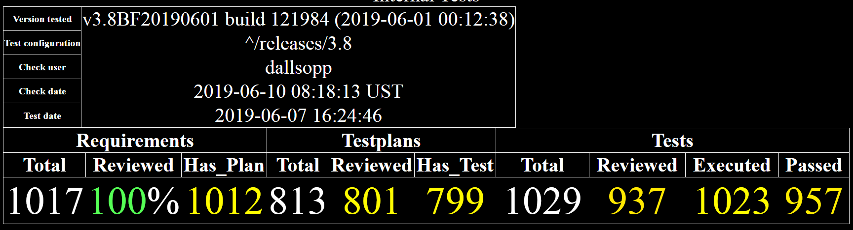
Example: RapiCover Qualification Kit Progress
Dashboard view 17/5/2019
Dashboard view 10/6/2019

Slide 17
Applying the new process
Monolithic QK
V 3.7 April 2018
~4 person years effort over 14 months
V 3.8 January 2019. Spec frozen
Modular QK 3.8
V 3.8a June 2019
Fast, low effort!
Modular QK 3.9
V 3.9 ~July 2019
If no changes, QK release is 0.5 days.

Slide 18
Effort estimates
 | Monolithic | Modular
Effort to release a new version (with no changes) | 15 person days | 0.5 person days
Conversion from old to modular system | X | 48 person months
Problems to date
Checker has found more inconsistencies/issues (better, but they need fixing!)
How to test the tools that generate the QK!
Needs additional GUI support for reviewing trivial differences, displaying errors and action
Timesaving hook for trivial changes: a typo fix doesn’t need to review the test plan against the change.

Slide 19
Conclusion and plans
Rapita’s Qualification data changed from monolithic to modular structure
3 tools RapiCover, RapiTime, RapiTest
  First one released this week!
Pro | Con
Faster incremental changes | Expensive change
Text format | Lots of tool investment
Traceability
Smaller, faster QK
Continuous integration
Subsets

