Slide 1
Something old,
Something new,
Something Ada!
Success through Innovation
Ian Broster, Steve Rymer
ianb@rapitasystems.com, srymer@rapitasystems.com
Notes:
30 minutes Wed 16:30-17:00

Slide 2
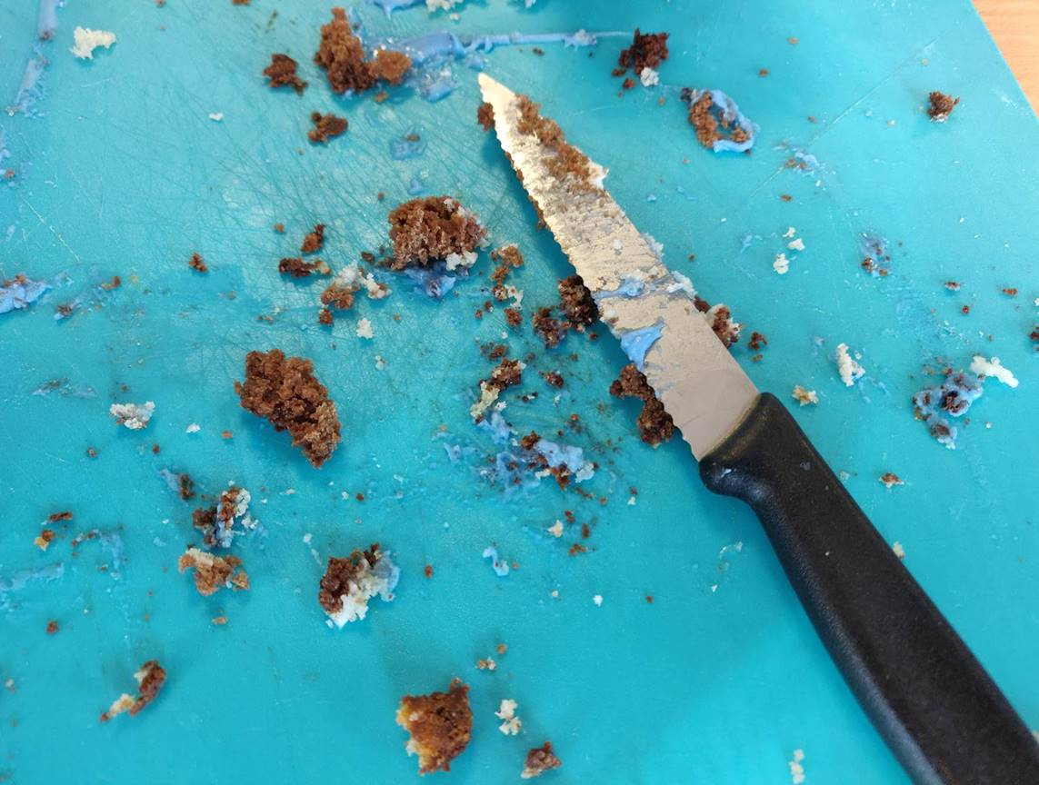
Rapita is 15 years old!

Slide 3
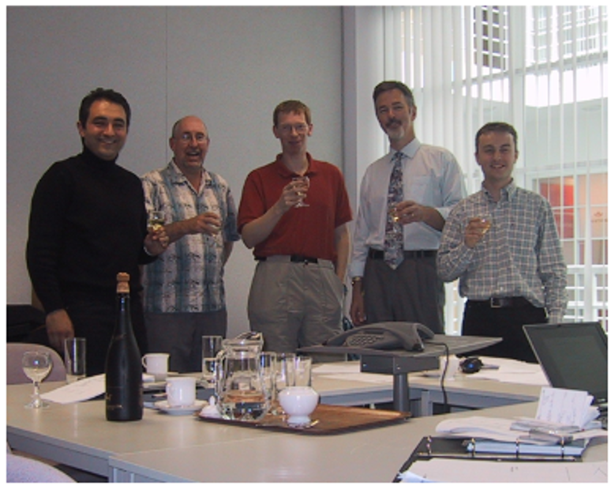
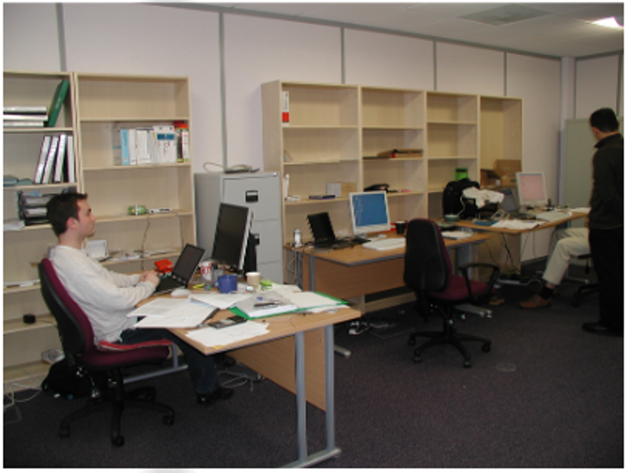
2004

Slide 4
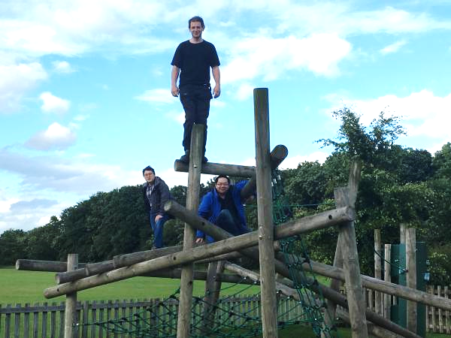
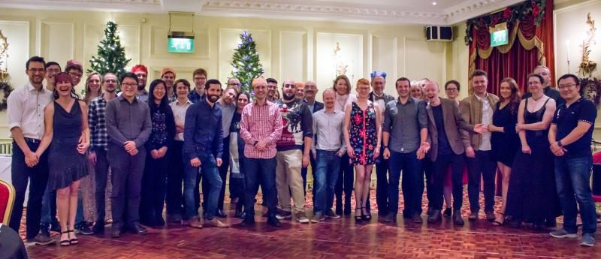
2019

Slide 5
15 years of software innovation
AMASS

Slide 6
What does Rapita do?
Advanced technologies for reducing V&V costs
Revolutionize your software verification

Slide 7
Rapita in Ada & Aerospace – recent things
2019 - Rapita Systems Inc
Launched new USA company/branch
Helping US customers
Multicore timing solution
RapiTest tool – first flights

Slide 8
A challenge with multicore performance
Single Core
A
B
A
2 Cores
Twice as fast?
B
A
?
2 Cores
B
A
?
2 Cores
B

Slide 9
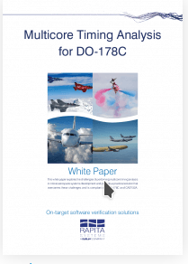
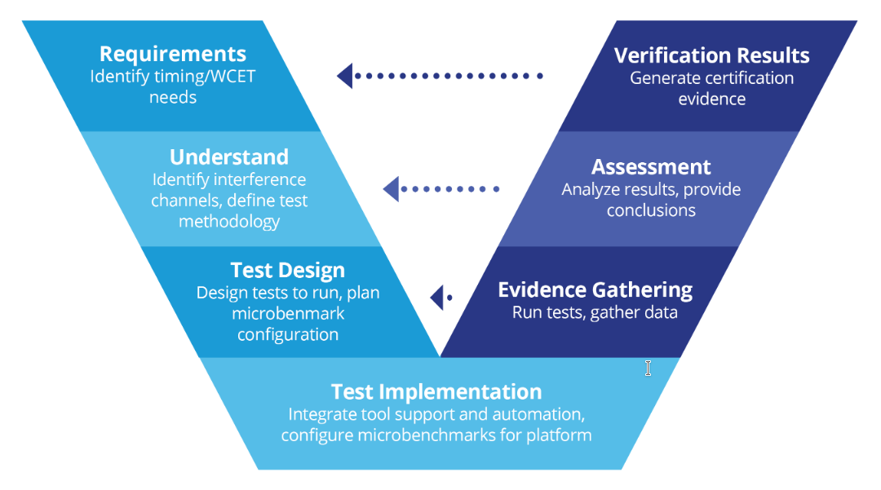
Multicore timing verification solution
How long does your software take on multicore/parallel?
How do you understand/predict/limit how different cores interfere with each other?
Download the multicore white paper
Process
Tools

Slide 10
2019 – after 4 years of R&D
RapiTest launched as a core product
“merged into trunk”
Several “first flight” projects tested with RapiTest
Goal of RapiTest:
Efficient software testing (without writing a line of code)
Unit-test, system test, coverage
Ada, C, C++
DO-178C, ISO-26262
Would you like to try it?

Slide 11
RapiTest Philosophy: Efficient People
People
Machines
Design good tests
Work out how to implement tests
Run tests
Analyse Results
In many DO-178C projects, testers cannot even “see” the source
No “User code” – tester should not have to write any code to test Ada

Slide 12
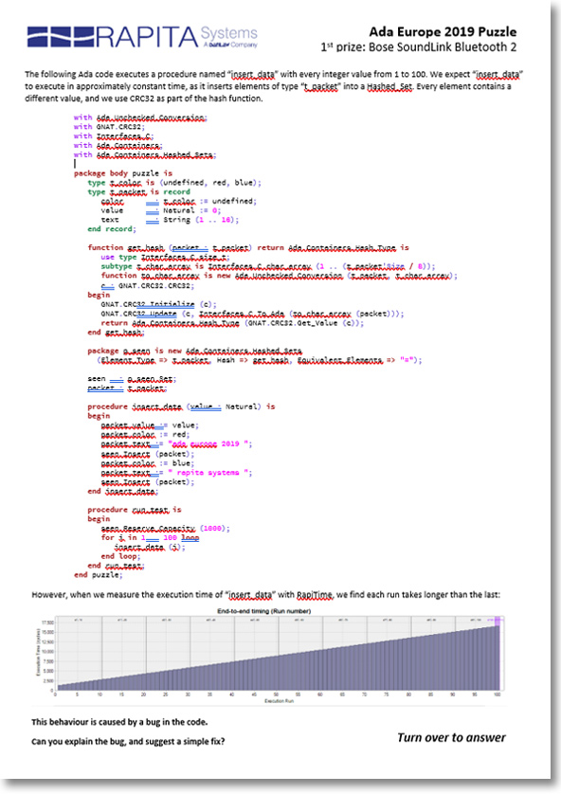
Puzzle
Drop your entry at our stand before leaving.
We’ll judge the winner next week.

Slide 13
Fast, flexible DO-178C tool qualification using a modular approach
Tomorrow
Ian Broster, Zoë Stephenson,
David Allsopp, Sevane Fourmigue, Daniel Wright
ianb@rapitasystems.com
This research was funded by the E.U. ARTEMIS project AMASS.

Slide 14
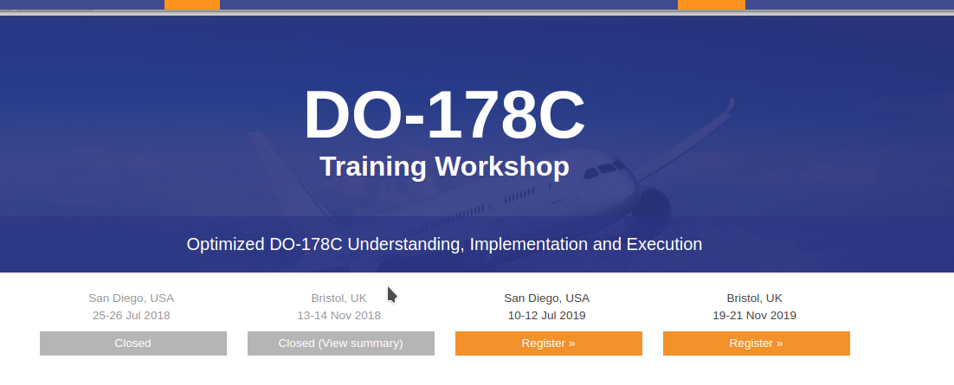
Training Webinars and Workshops
Tomorrow

Slide 15
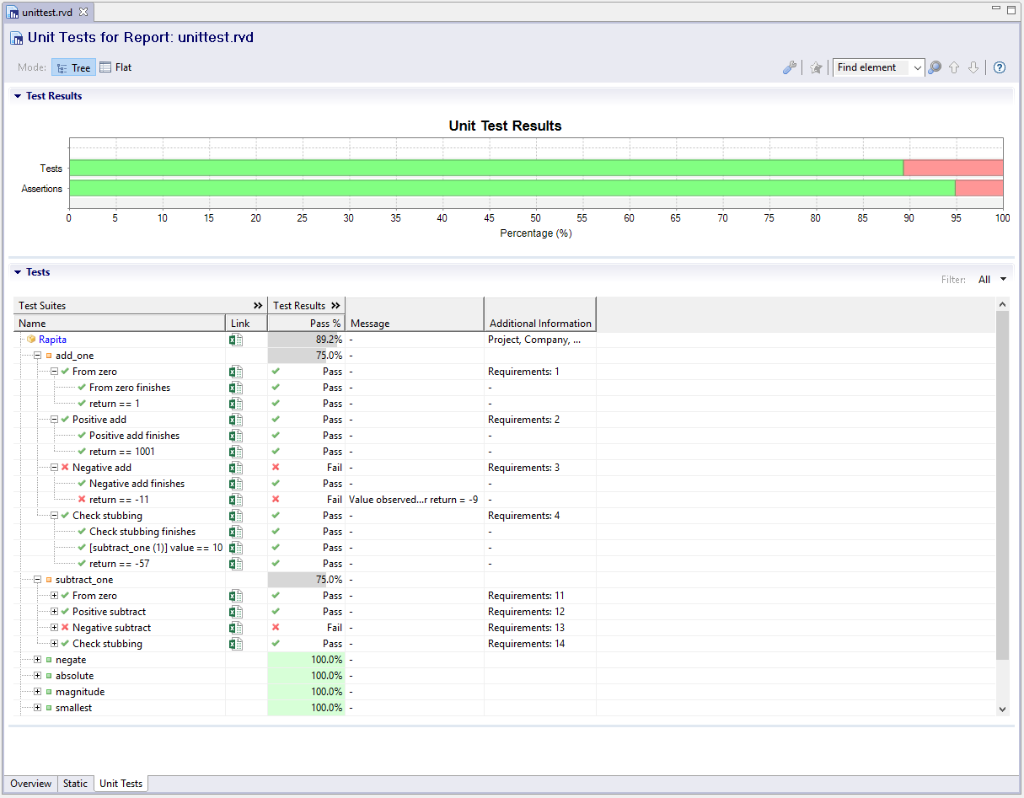
A fun demo & competition
Tetris

Slide 16
RapiTetris
Test your software testing skills:
Get highest structural code coverage
Try on our stand
Download and play
www.rapitasystems.com/TetrisComp

